Slide 1
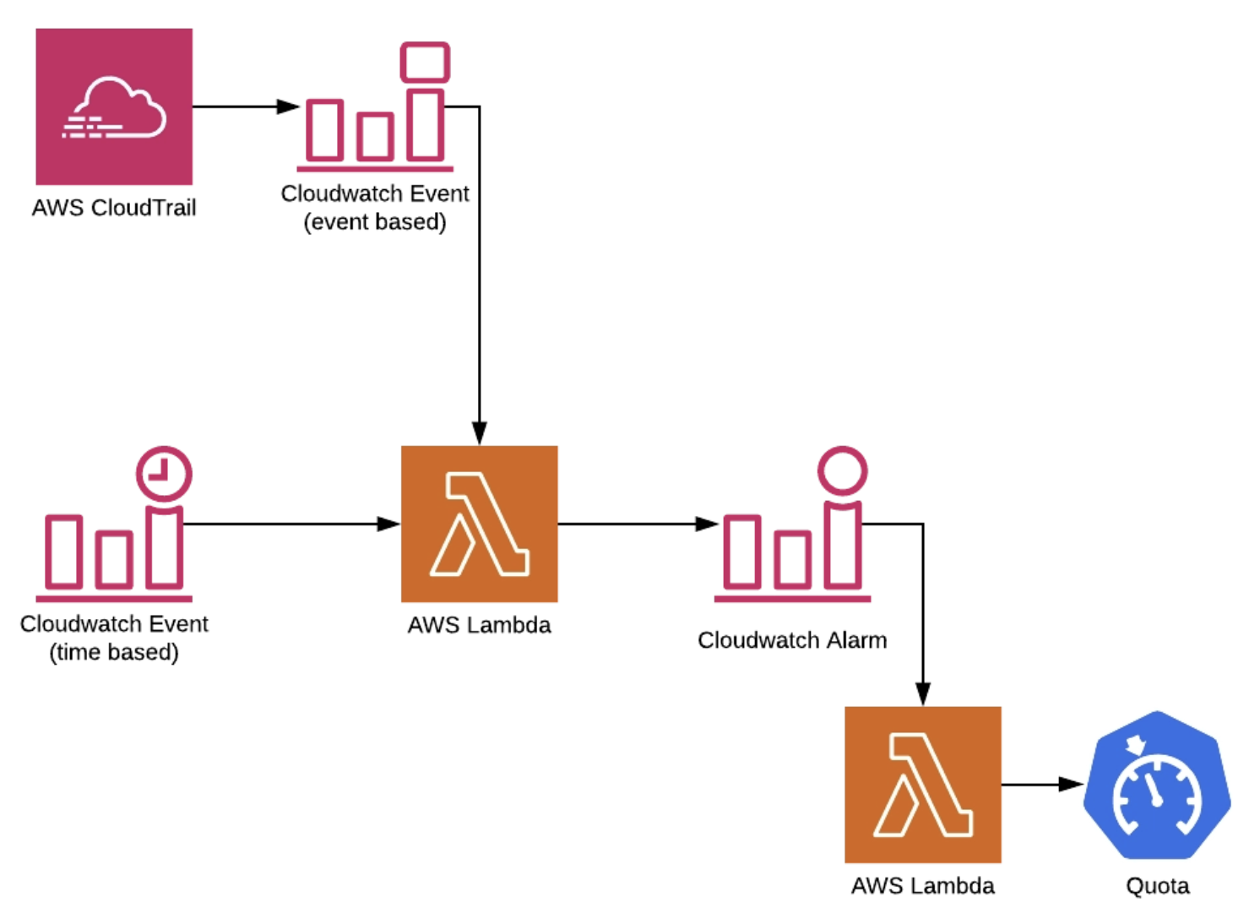
How to Automate Service Quotas Requests for Your AWS Services
Many engineers find AWS Service Quotas limiting, and in some cases prevent the deployment of applications. Here I have outlined how to implement a custom automation built on serverless architecture with the help of AWS Lambda, AWS CloudWatch, AWS Service Quotas, AWS SNS and AWS CloudTrail.
Every AWS account has quotas (limits) applied to it. Some of the limits cannot be changed (hard limit) whilst others can be easily changed by logging increase request to AWS support. Not being able to deploy your new application because of hitting a quota (limit) on a specific AWS service can be frustrating and keeping track of all service quotas can prove challenging. However, using AWS Service Quotas and some automation with AWS Lambda you can take this pain away.
AWS Service Quotas is a service specifically designed to help you monitor the limits applied to your AWS account. It is tightly integrated with AWS CloudWatch, so you can have an overview of your current usage of AWS services and even raise alarms to notify you before you hit a specific limit. Today Service Quotas support only a handful of usage metrics, however further developments are on the horizon. Currently quota increase requests can be submitted directly from AWS Service Quotas.
For the purposes of this task, let’s make use of two Lambda functions – one for automatically creating quota alarms for every AWS service used in the account, and one for submitting new quota increase request based on the alarms provided by the first function. This solution assumes that you have AWS CloudTrail already enabled. By making use of Python and boto3 for building both functions, you can use your favorite programming language if it is supported by AWS Lambda.
https://helecloud.com/blog/how-to-automate-service-quotas-requests-for-your-aws-services/

